Slide 1
Crystals
yzhu303@ucr.edu
Notes:
Hello everyone.
For today's microteaching session, I’d like to give a brief introduction to crystals.
Since the course I TA is primarily designed for non-CS majors, I thought presenting a non-CS topic would be a good way to simulate that teaching experience.

Slide 2
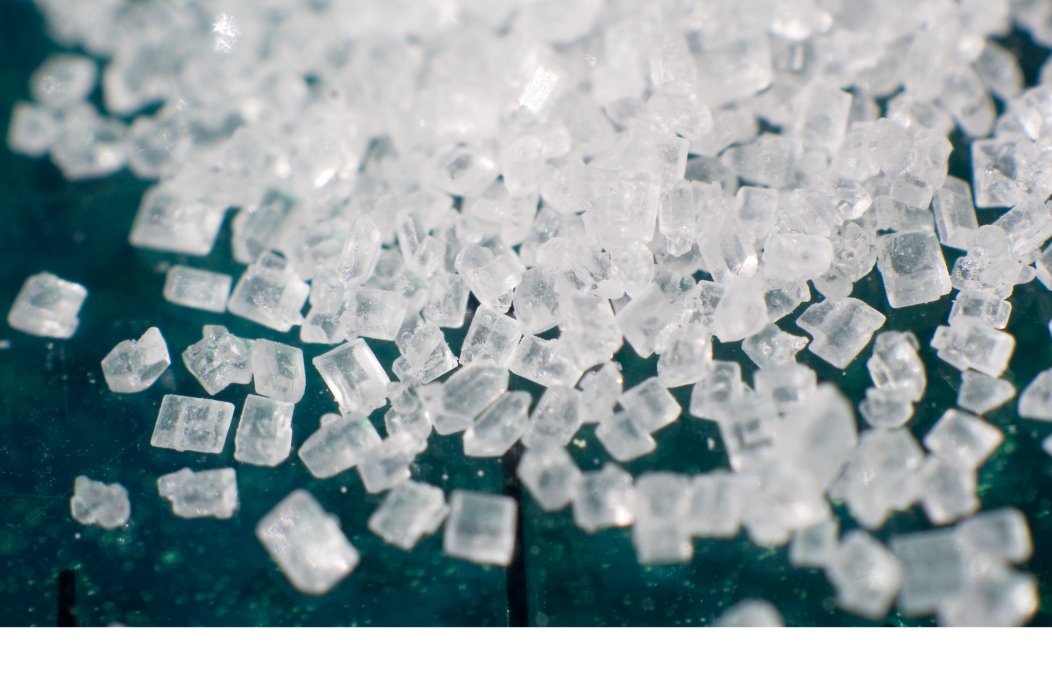
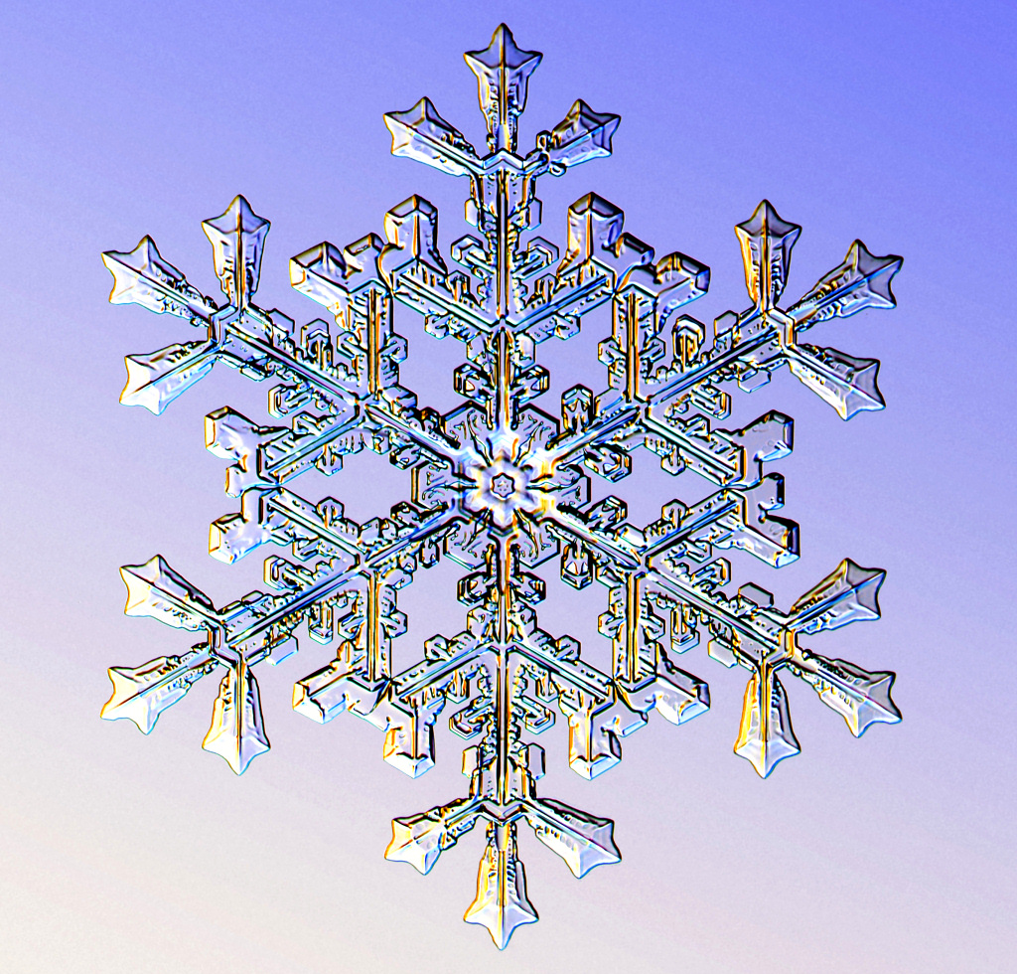
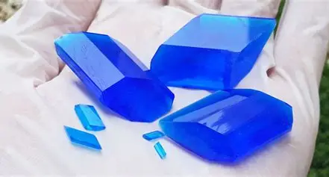
Crystals: The Hidden Order
Why is salt cubic?
Why are snowflakes hexagonal?
…
Notes:
Today we're going to talk about things you see every day: salt, sugar, snowflakes, and diamond.
Have you ever wondered why salt grains seem to be tiny cubes? Why are all snowflakes variations of a hexagon?
The answer to all of this is hidden in the word 'crystal.'

Slide 3
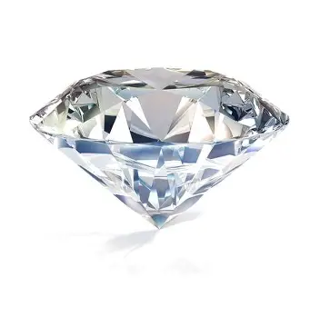

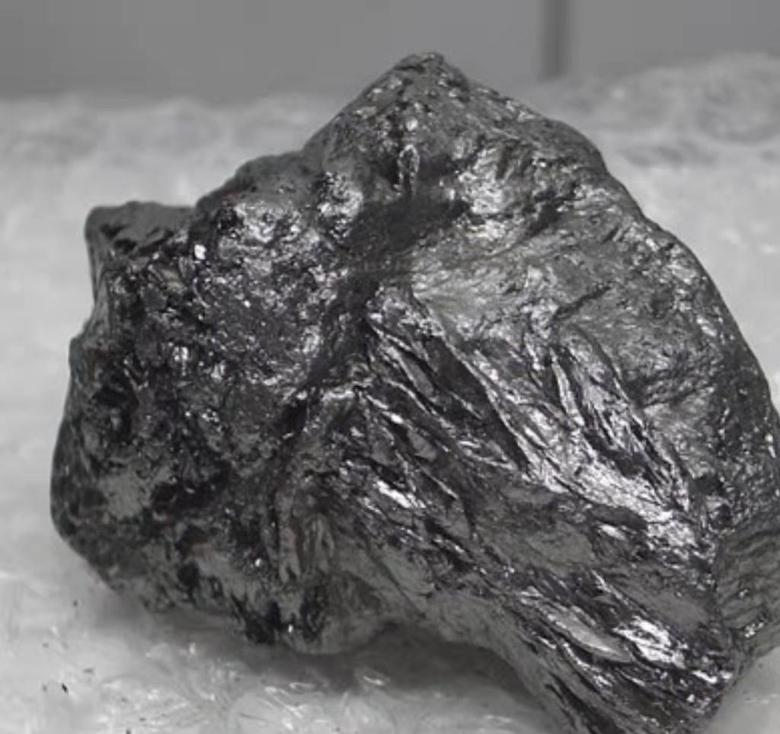
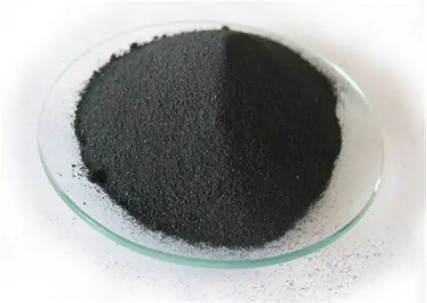
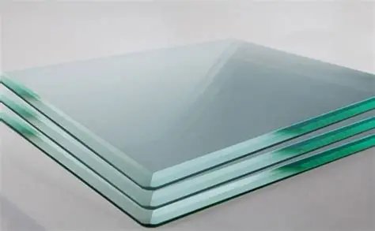
What is a Crystal?
graphite
iron powder
Non-crystal
They are all crystals!
Notes:
When I say ‘crystal,’ you probably picture this, a diamond.
But in science, 'crystal' describes an internal state.
We all know diamond is a crystal.
In fact, gold is a crystal, even though it can be easily molded into any shape;
graphite is a crystal, even though it is very soft and slippery; powder can be crystals, ...
They are all crystals.
But glass is an amorphous solid.
So, what is a crystal?

Slide 4
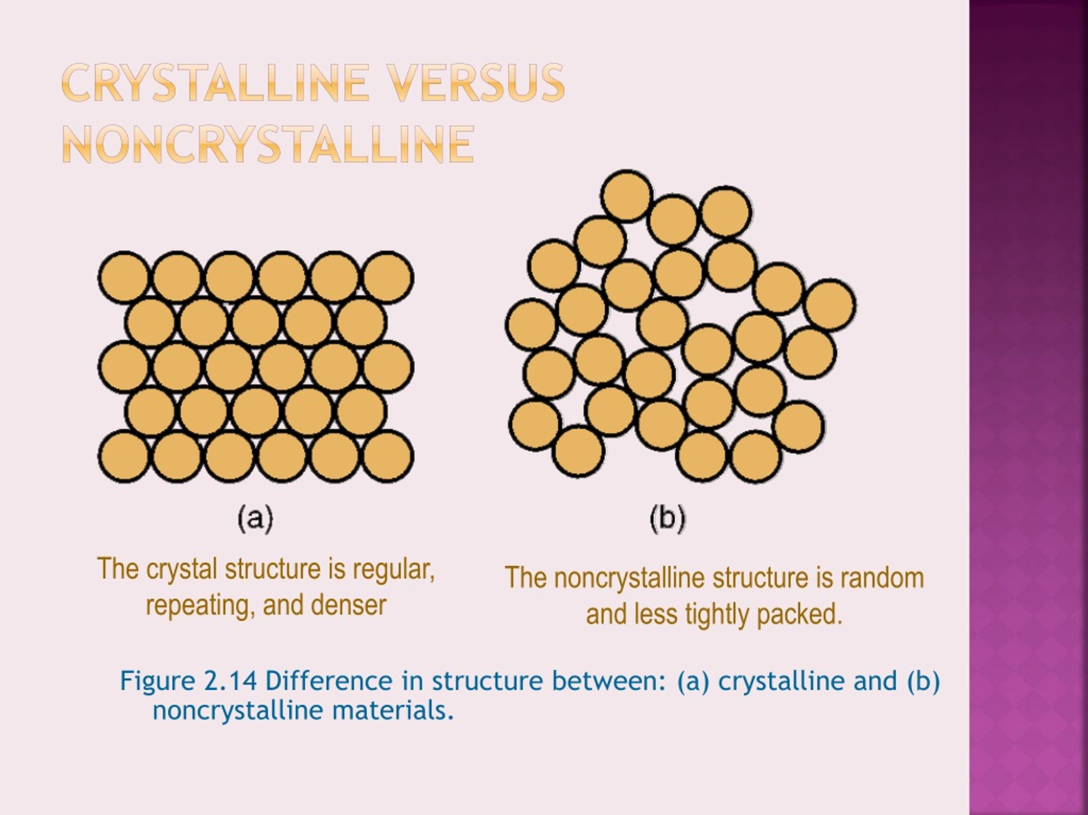
Crystal v.s. Non-crystal
Crystal: The internal particles (atoms, molecules) are arranged in a highly ordered, repeating pattern.
Non-crystal(Amorphous solid) : The internal particles are disorganized and random (also restricted to solids)
Notes:
The only secret to a crystal is its internal order.
Imagine the particles inside a crystal are highly-ordered, standing in a perfect formation. No matter which way you look, the pattern repeats itself over and over.
Btw, when we say it 'repeats,' we mean the pattern extends infinitely in 2D or 3D space.
And a 'non-crystal'? There is no pattern, no formation.
These are 2-dimensional examples showing the difference between crystal and non-crystal.

Slide 5
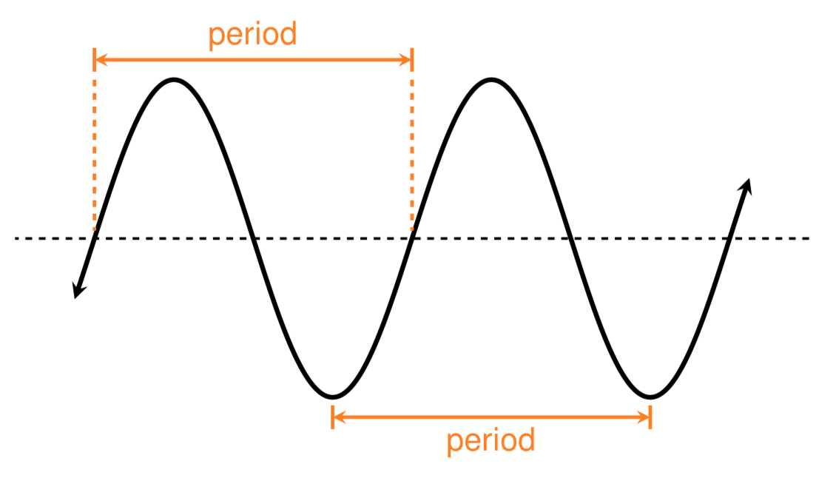
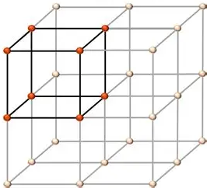
The Ultimate Definition
“Crystal: The internal particles (atoms, molecules) are arranged in a highly ordered, repeating pattern.”
Arranged into a three-dimensional periodic structure

Slide 6
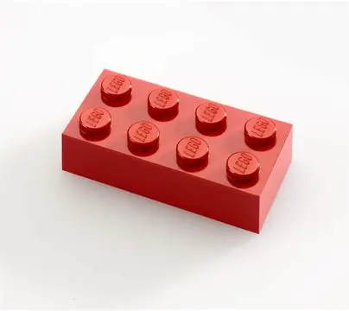
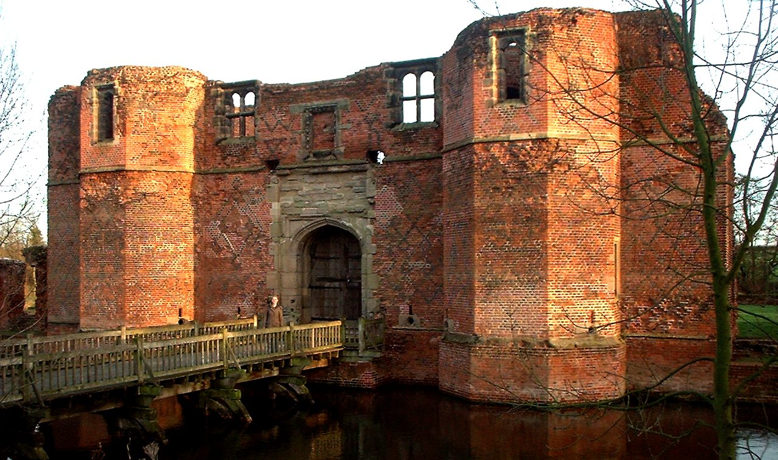
Unit Cell
Unit Cell: The smallest repeating unit that builds up the crystal. It's the "LEGO brick".
Crystal: The entire structure, built by stacking countless "unit cells" in all three dimensions.
Notes:
We said a crystal is a 'repeating pattern.' But what is the 'it' that's repeating?
That 'it' is called the Unit Cell.
The Unit Cell is just this: the single smallest building block of the entire crystal.
Remember: we require unit cell to be the smallest.

Slide 7
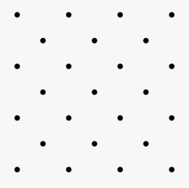
Puzzle: Find the repeating unit
Notes:
First, we identify the repeating unit by finding the lattice vectors.
Here, it is quite straightforward to notice two such vectors.
Then, the parallelogram spanned by these two vectors directly defines the repeating unit.
So the 2 dots in such a box is a repeating unit. And you can put the box anywhere in this picture. The position doesn’t matter.
But is it smallest?
Can you find a smaller period?

Slide 8
Puzzle: Find the Unit Cell
Notes:
Since it contains only one point, it is already the smallest possible unit.

Slide 9
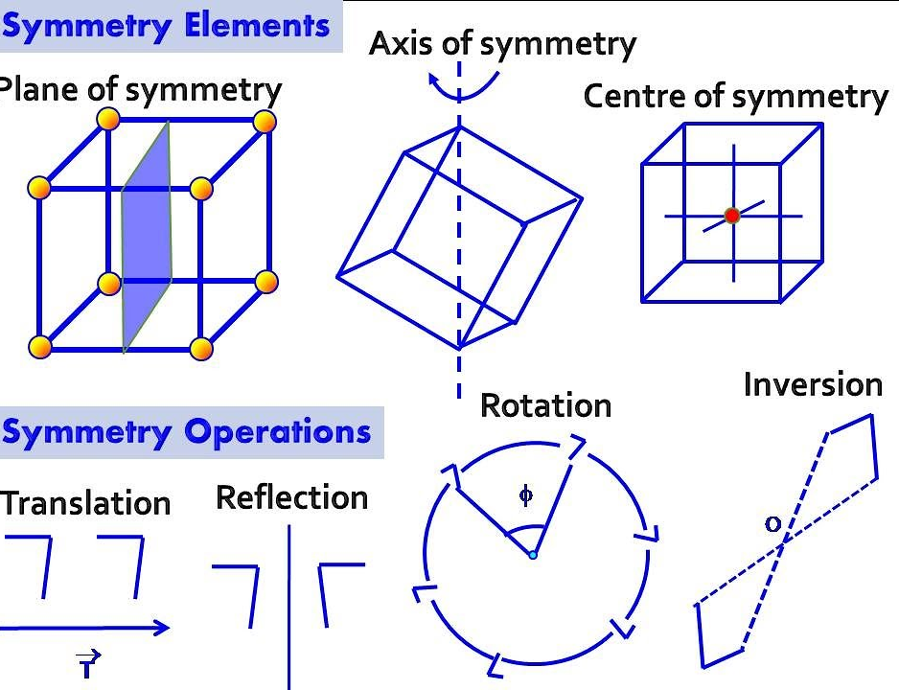
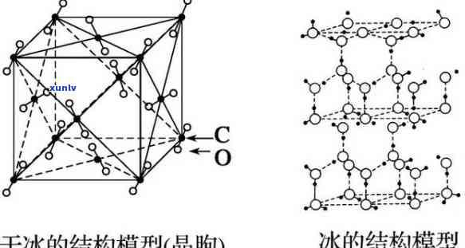
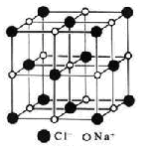
More Symmetry
Symmetry Operations
Translation (periodic "Copy-Paste")
Rotation ("Turn")
Reflection("Mirror")
Inversion
"Rules" Become "Shape"
Notes:
Let’s talk about the symmetry of crystals.
Translation is the simple act of repeating the unit cell over and over in a line.
Besides translation, crystals can possess other forms of symmetry.
Rotation means turning the cell by a specific angle (like 90°) and having it look exactly the same.
And this microscopic symmetry is exactly the reason why crystals exhibit specific macroscopic shapes.

Slide 10
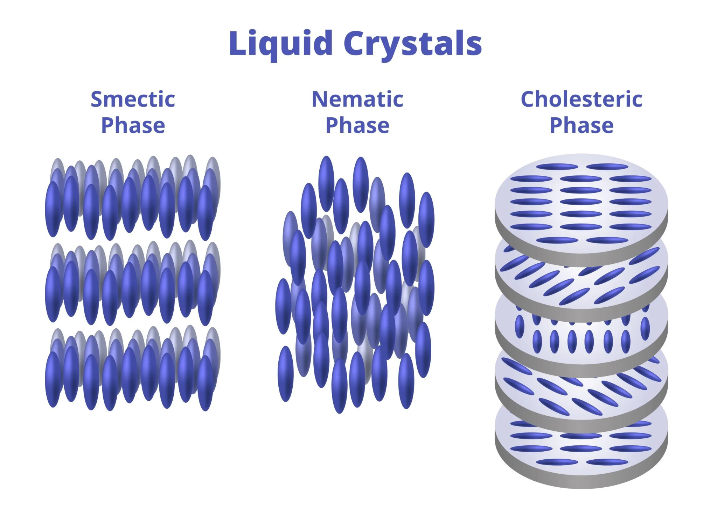
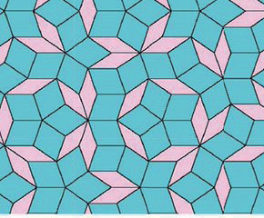
The "Oddballs" of Order
Liquid Crystal (LCD): Between a Liquid and a Crystal
Like a Liquid: Its molecules' positions are random (they can flow).
Like a Crystal: Its molecules' orientation (the direction they face) is ordered.
Quasicrystal — Ordered, but Never Repeating
Crystal = Built by repeating one unit cell.
Quasicrystal = Built using a few special bricks, following complex rules, to create an infinite, non-repeating mosaic.
Notes:
Indeed, we have some outliers.
LCD refers to a substance that can flow like a liquid but maintains some order like a crystal.
Quasicrystal refers to a solid that is ordered, but its internal pattern never repeats itself.

Slide 11
Summary
Crystal = Internal Particles "Lined Up"
The key is order and repetition.
The opposite is Amorphous (like glass), which is chaos.
Unit Cell = The "LEGO Brick"
The crystal is built by repeating this one minimum unit.
Structure Determines Property
How they line up determines if something is hard like a diamond or soft like graphite.

